Slide 1
Unit 4: LEARNING
Concepts of machine learning

Slide 2
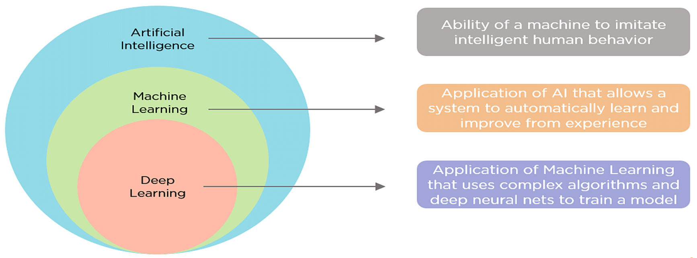
Introduction to Machine learning
What is the difference between Machine Learning ,Artificial Intelligence and Deep Learning

Slide 3
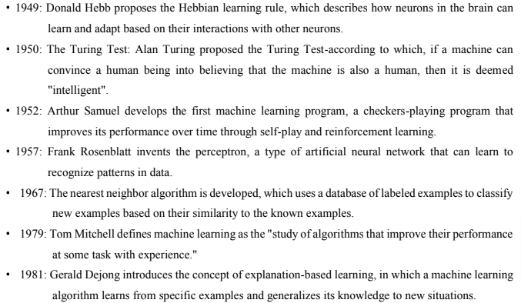
History of Machine Learning
Some major milestones and developments in the history of machine learning

Slide 4
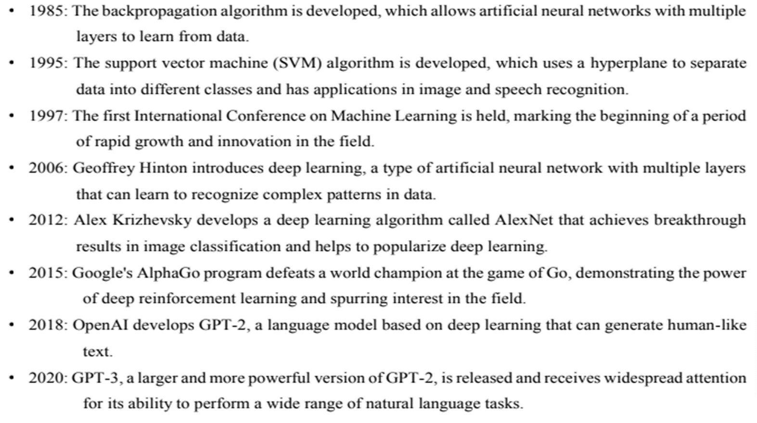

Slide 5
Machine learning
Arthur Samuel, an early American leader in the field of computer gaming and artificial intelligence, coined the term “Machine Learning” in 1959 while at IBM. He defined machine learning as “the field of study that gives computers the ability to learn without being explicitly programmed.”
Other definition
Machine Learning, often abbreviated as ML, is a subset of artificial intelligence (AI) that focuses on the development of computer algorithms that improve automatically through experience and by the use of data. In simpler terms, machine learning enables computers to learn from data and make decisions or predictions without being explicitly programmed to do so.
In traditional programming, a computer follows a set of predefined instructions to perform a task. However, in machine learning, the computer is given a set of examples (data) and a task to perform, but it's up to the computer to figure out how to accomplish the task based on the examples it's given.

Slide 6
For instance, if we want a computer to recognize images of cats, we don't provide it with specific instructions on what a cat looks like. Instead, we give it thousands of images of cats and let the machine learning algorithm figure out the common patterns and features that define a cat. Over time, as the algorithm processes more images, it gets better at recognizing cats, even when presented with images it has never seen before.
This ability to learn from data and improve over time makes machine learning incredibly powerful and versatile. It's the driving force behind many of the technological advancements we see today, from voice assistants and recommendation systems to self-driving cars and predictive analytics

Slide 7
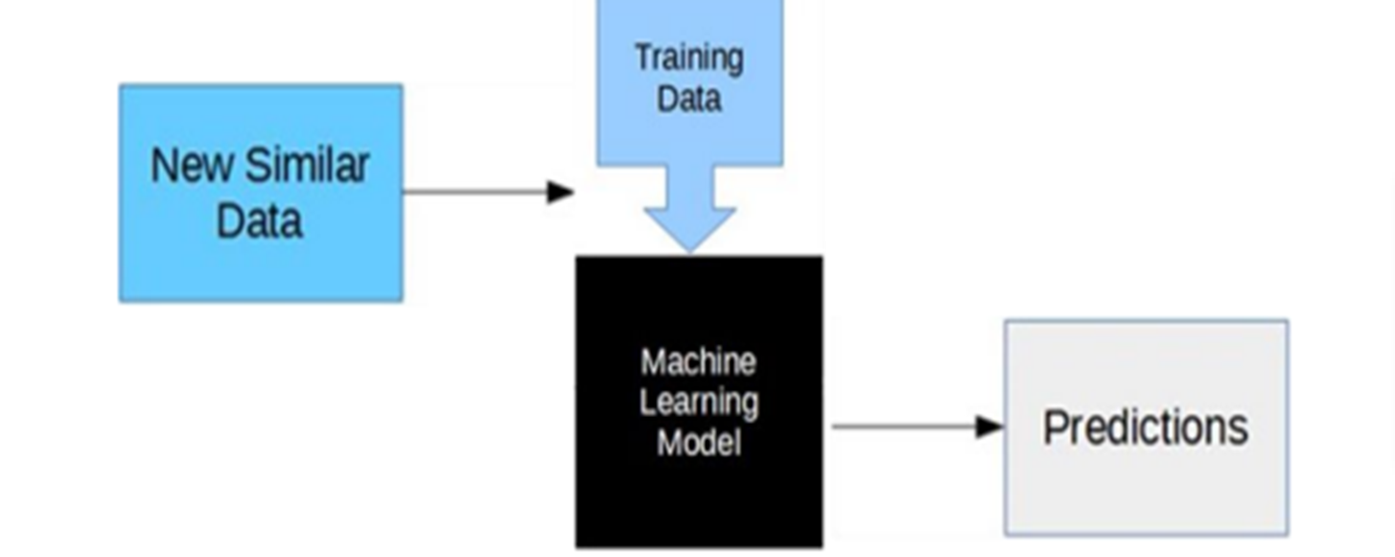
How machine learning works

Slide 8
Collecting Data
Preparing Data
Choosing a Model
Training the Model
Evaluating the Model
Improving the Model
Making Predictions

Slide 9
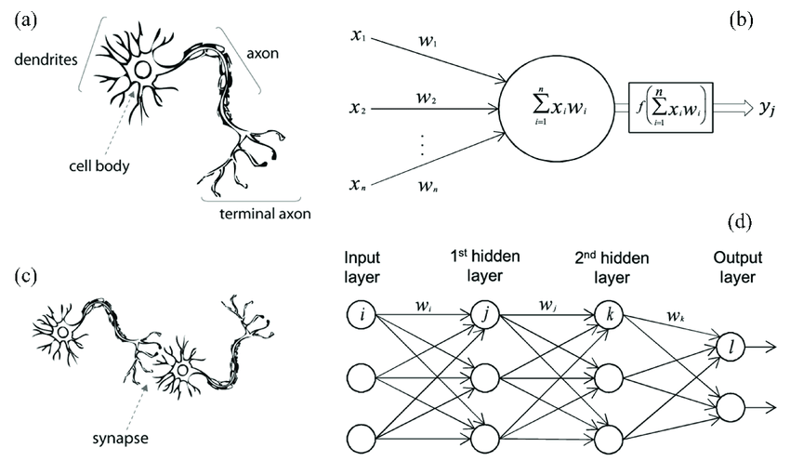
Brain- neuron learning system

Slide 10
The inspiration for neural networks comes from the extraordinary architecture of the brain.
Biological neurons are cells that process and transmit information in the brain and nervous system.
Artificial Neurons, also known as nodes or units, are the building blocks of neural networks. These computational units are designed to simulate the behavior of biological neurons.
In artificial neural networks, each neuron is represented by a node that takes in input signals from other nodes through weighted connections.
The input signals are transformed by an activation function to determine whether the neuron should fire an output signal.
Learning in both biological and artificial neural networks occurs through the strengthening or weakening of the connections between neurons.
In biological neurons, this is achieved through synaptic plasticity.
In artificial neural networks, this is achieved through training algorithms such as back propagation
The brain neuron learning system is a complex and dynamic process that involves many different factors and mechanisms

Slide 11
Definition and Type of learning models
Learning refers to the process of acquiring knowledge, skills, or behaviors through experience, study, or instruction. It is a fundamental aspect of human and animal cognition and is also a key area of study in machine learning and artificial intelligence.
The different types of learning models mentioned
Learning Models
Machine learning models are algorithms or mathematical representations that are trained on data to make predictions or perform specific tasks. Here are some commonly used machine learning models:
Linear Regression: A model used for regression tasks, where the goal is to predict a continuous numerical value based on input feature. It assumes a linear relationship between the features and the target variable.
Logistic Regression: A model used for binary classification tasks, where the goal is to predict one of two classes. It estimates the probability of the input belonging to a certain class using a logistic function

Slide 12
3. Decision Trees: A model that uses a tree- like structure to make decisions based on feature values. Each internal node represents a decision based on a feature, and each leaf node represents a predicted class or value.
4. Random forest: An ensemble model that combines multiple decision trees to make predictions. It aggregates the predictions of individual trees to produce a final prediction.
5. Support Vector Machines(SVM): A model that separates data points into different classes using hyperplanes in high- dimensional spaces. It aims to maximize the margin between classes
6. Neural Networks: Deep learning models composed of interconnected layers of artificial neurons. They can learn complex patterns and relationships from data, making them suitable for tasks such as image recognition and natural language processing.
7. Naïve Bayes: A probabilistic model based on Bayes; theorem that assumes independence among features . It is commonly used for text classification tasks such as spam detection and sentimental analysis.

Slide 13
8. K-nearest Neighbors(KNN): A model that classifies data points based on the classes of their nearest neighbors. It assigns a new point to the majority class among its k nearest neighbors.
9. Gradient Boosting Models: Ensemble models that combine multiple weak learners(typically decision trees) to create a strong learner. Examples include Gradient Boosting Machines (GBM), XGBoost, and lightGBM.
10. Hidden Markov Models(HMM): A statistical model used for sequence data, where the underlying system is assumed to be a Markov process with hidden stats. HMMs are widely used in speech recognition and bioinformatics
These are just a few examples of machine learning models, and there are many more algorithms and variations available depending on the specific problem and data characteristics. Each model has its strengths, limitations, and suitability for different types of tasks.

Slide 14
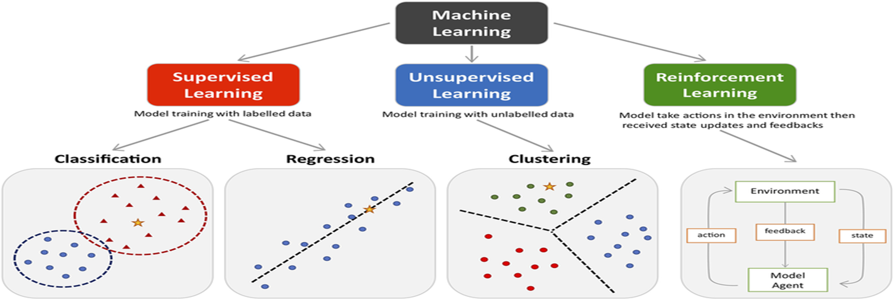
Different types of learning
Machine learning algorithms can be classified into three types

Slide 15
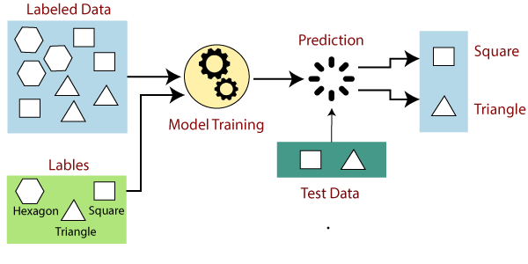
Supervised Learning
It is a form of machine learning in which the algorithm is trained on labeled data to make predictions or decisions based on the data inputs. In supervised learning, the algorithm learns a mapping between the input and output data. This mapping is learned from a labeled dataset, which consists of pairs of input and output data. The algorithm tries to learn the relationship between the input and output data so that it can make accurate predictions on new, unseen data.

Slide 16
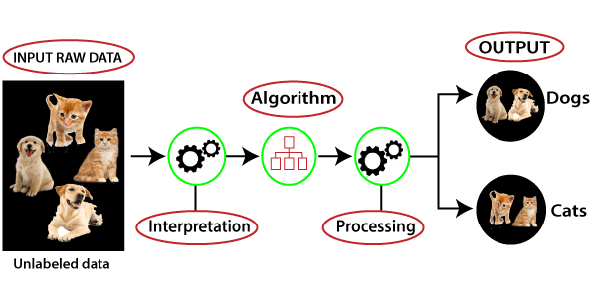
2. Unsupervised Learning
Unsupervised learning is a type of machine learning technique in which an algorithm discovers patterns and relationships using unlabeled data. Unlike supervised learning, unsupervised learning doesn’t involve providing the algorithm with labeled target outputs. The primary goal of Unsupervised learning is often to discover hidden patterns, similarities, or clusters within the data, which can then be used for various purposes, such as data exploration, visualization, dimensionality reduction, and more.
The most common unsupervised learning method is cluster analysis, which is used for exploratory data analysis to find hidden patterns or grouping data

Slide 17
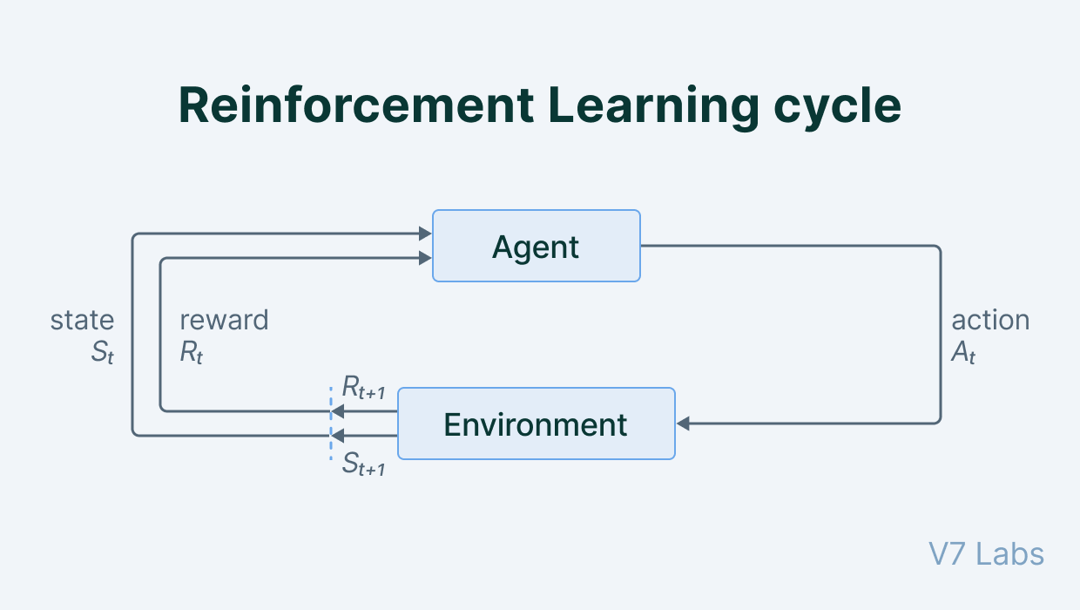
Reinforcement learning
In a Reinforcement learning there is a learner and a decision maker called agent and the surrounding with which it interacts called environment.
The environment, in return, provides reward and a new state based on the actions of the agent.
So, in the reinforcement learning, we do not teach an agent how it should do something but presents it with rewards whether positive or negative based on the actions.

Slide 18
Data and Tools
Data and tools are essential components of machine learning
Data
Data is the raw material that machine learning algorithms use to learn patterns, make predictions, and perform other tasks.
Good quality data is essential for machine learning, as the accuracy and effectiveness of the algorithms depend on the quality of the data used to train them.
In machine learning data is typically divided into training, validation, and testing sets.
The training set is used to train the machine learning algorithms, while the validation set is used to evaluate the performance of the algorithm during training. The testing set is used to evaluate the performance of the final model
Tools
Tools are software programs and libraries that are used to implement machine learning algorithms and analyze data. There are several popular machine learning.

Slide 19
Programming Languages
Python: Python is a popular programming language for machine learning, with many libraries and frameworks such as NumPy, Pandas, and Scikit-Learn, which provide data analysis, machine learning algorithms, and data visualization capabilities.
R: R is a programming language and environment for statistical computing graphics, widely used in machine learning and data science. It provides many packages for data manipulation, visualization, and machine learning.
Frameworks and libraries
TensorFlow: Tensorflow is an open-source machine learning library developed by google, which provides a wide range of machine learning algorithms and tools for deep learning, natural language processing, and computer vision
PyTorch: PyTorch is an open-source machine learning library developed by Facebook, which provides a flexible platform for building and training machine learning models, including deep neural networks.
Scikit-Learn: A comprehensive library for classical machine learning algorithms. Includes tools for data preprocessing, model selection, and evaluation.

Slide 20
Integrated Development Environments(IDEs)
Jupyter Notebook: Jupyter notebook is an open-source web application that allows users to create share documents that contain live code, equations, visualization, and narrative text. It is widely used in data science and machine learning for data exploration, experimentation, and visualization.
Google Colab: A free cloud service with support for Jupyter Notebooks. Provides free GPU and TPU resources.
Cloud Services
Google AI Platform: Managed services for training and deploying models. Supports TensorFlow, Keras, and Scikit-Learn.
Amazon SageMaker: Fully managed service for building, training, and deploying ML models. Integrates with other AWS services.
Microsoft Azure ML: Cloud-based environment for machine learning. Supports various frameworks like TensorFlow, PyTorch, and Scikit-Learn.

Slide 21
4.2
Rote learning:
Rote learning is a memorization technique that involves repeating information until it is committed to memory.
Characteristics:
No generalization or reasoning.
Direct storage of input-output pairs.
Fast retrieval but limited applicability.
Example: Memorizing multiplication tables.
Pros: Simple and fast for specific tasks.
Cons: Lacks flexibility and cannot handle unseen data.

Slide 22
Pros: Encourages creativity and problem-solving.
Cons: Requires a rich knowledge base and may fail if similarities are weak.
Pros: Encourages creativity and problem-solving.
Cons: Requires a rich knowledge base and may fail if similarities are weak.
Learning by analogy:
Learning by analogy involves understanding new concepts by relating them to familiar ones. It tries to Solve new problems by comparing them to similar past problems.
Characteristics:
Comparative Understanding: Learners use known information to make sense of new information.
Cognitive Engagement: Encourages critical thinking as students analyze similarities and differences between concepts.
Example: Solving a new math problem by comparing it to a previously solved one.
Pros: Encourages creativity and problem-solving.
Cons: Requires a rich knowledge base and may fail if similarities are weak.

Slide 23
Inductive Learning
Inductive learning is a method where learners derive general principles from specific examples or Learning general rules or patterns from specific examples.
Characteristics:
Generalizes from observed data.
Used in supervised learning (e.g., classification, regression).
Example: Predicting house prices based on historical data.
Pros: Can handle unseen data and generalize well.
Cons: Requires large datasets and may overfit.

Slide 24
Explanation Based Learning:
Explanation-based learning focuses on understanding why things happen rather than just what happens. It involves learners explaining concepts in their own words, which bring up deeper comprehension.
Characteristics:
Uses domain knowledge to explain why something is true.
Focuses on understanding rather than memorization.
Example: Learning chess strategies by understanding why a move is good.
Pros: Produces highly accurate and interpretable models.
Cons: Requires extensive domain knowledge and may be computationally expensive.

Slide 25
Learning by evolution(genetic algorithm):
Genetic algorithm are the subset of a much larger branch of computation known as Evolutionary computation.
A genetic algorithm(GA) is a search heuristic that is inspired by the process of natural selection. GA’s are used to find approximate solutions to optimization and search problems in AI and computer science.
The basic idea behind a genetic algorithm is to use a population of candidate solutions, called individuals or chromosomes, that evolve over time towards better solutions. The evolution is guided by a fitness function that measures the quality of an individual in terms of how well it solves the problem at hand.
Analogies in Genetic Algorithm
Chromosome: A potential solution to the problem.

Slide 26
Gene: one element position of a chromosome
Population: A set of potential solutions.
Fitness Function: A measure of how good a solution is.
The process of a genetic algorithm typically consists of the following steps:
Initialization: A population of individuals is generated randomly
Evaluation: Each individual in the population is evaluated using the fitness function.
Selection: individuals with high fitness values are more likely to be selected to produce offspring.
Crossover: the selected individuals are combined to create new individuals through a process called crossover or recombination.
Mutation: small random changes are introduced to the new individuals through a process called mutation.
Replacement: the new individuals replace the old ones in the population and the process continues.

Slide 27
Termination: after replacement has been done, a stopping criterion is used to provide the basis for termination. The algorithm will terminate after the threshold fitness solution has been attained. It will identify this solution as the best solution in the population.
Application of Genetic Algorithms
Optimization Problems:
Traveling Salesman Problem (TSP), job scheduling, resource allocation.
Machine Learning:
Feature selection, hyperparameter tuning, neural network training.
Engineering Design:
Aerodynamic design, structural optimization.
Game Development:
AI for strategy games

